Slide 1
LIFE CYCLES OF LIVING ORGANISMS

Slide 2
We are teaching you these
Examples for life cycles.
Life cycles of animals.
Life cycle of human.
Metamorphosis.
Types of Metamorphosis.
Completed metamorphosis.
InCompleted metamorphosis.
Life cycles of plants.
Importance of learning life cycles.
Sensitive stages of animals
Morals

Slide 3
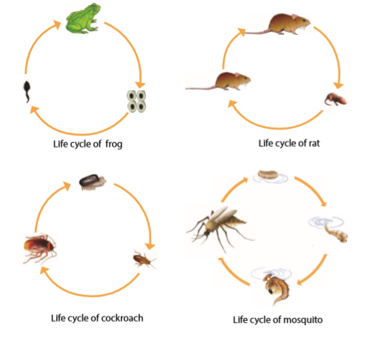
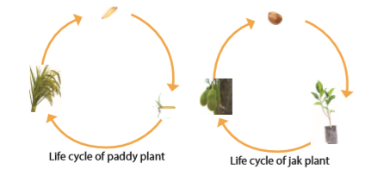
EXAMPLES FOR LIFE CYCLES

Slide 4
Life cycles of animals
Some animals like rat born morphologically similar to their parents, but smaller in size. Some animals go through difficult life cycle to be an adult. Like butterfly , mosquito, frog etc. All of them are born from eggs.

Slide 5
Life cycle of Humans
There are 3 stages of human life cycle too. They are,
Childhood
Adolescence
Adult

Slide 6
Metamorphosis
Some living organisms go through comparatively different morphological changes in different stages of their life cycle, to become adults.it is known as METAMORPHOSIS

Slide 7
Types of Metamorphosis
There are 2 types of metamorphosis. They are,
Completed metamorphosis
Incompleted metamorphosis

Slide 8
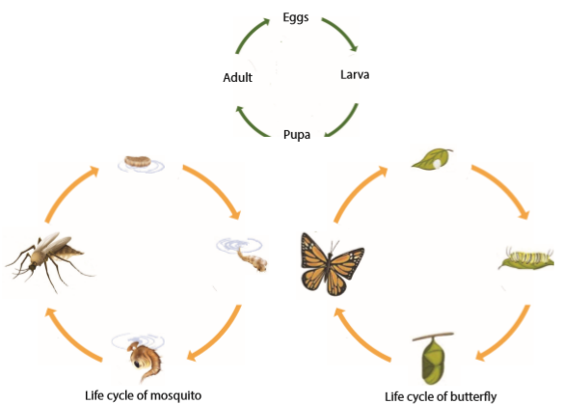
Completed Metamorphosis
If an animal exhibits significant morphological differences in its stages of life such as the egg, larva, pupa and adult, it is called
COMPLETED METAMORPHOSIS
You can see example for it on right side.

Slide 9
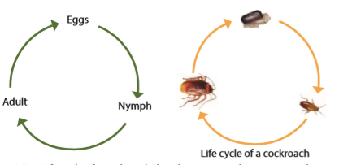
Incompleted Metamorphosis
Metamorphosis that does not show any significant morphological changes in the stages of life cycle is known as
incomplete metamorphosis.;

Slide 10
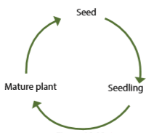
Life cycles of plants

Slide 11
Importance of learning the life cycles
For pest control.
For the control of human disease vector.
For the conservation of biodiversity.

Slide 12
Sensitive stages of some of animals you’ve learned
Some insecTs - larvae
Fish – eggs
Turtles – eggs and Young turtles
Frogs – eggs and tadpoles

Slide 13
Morals
Every living organism has a life cycle with different stages.
Some organisms have significant differences in the stages of life cycle, but some do not have significant differences in the stages.
The process with a sequence of morphological changes that some living organisms go through to become an adult is known as metamorphosis.
Metamorphosis with significant morphological changes in the stages is known as complete metamorphosis.
Metamorphosis without significant morphological changes in the stages is known as incomplete metamorphosis.
Flowering plants too go through different stages from growth of the seed till becoming an adult plant in its life cycle.
The creatures that harm the crops and harvest of human is called as pests.
For a successful pest control there should be a knowledge about the harmful stage of the particular pest.
It is important to protect the valubale stages of the life cycle of organisms for conservation of biodiversity.
In conservation of endangered species is important to consider about the sensitive stage of the endangered organism

Slide 14


